Slide 1
free swimming

Slide 5

FM sound

Slide 6
gap

Slide 7

social reward

Slide 8
break

Slide 13
gap

Slide 15
break

Slide 19
CF sound

Slide 20
gap

Slide 21
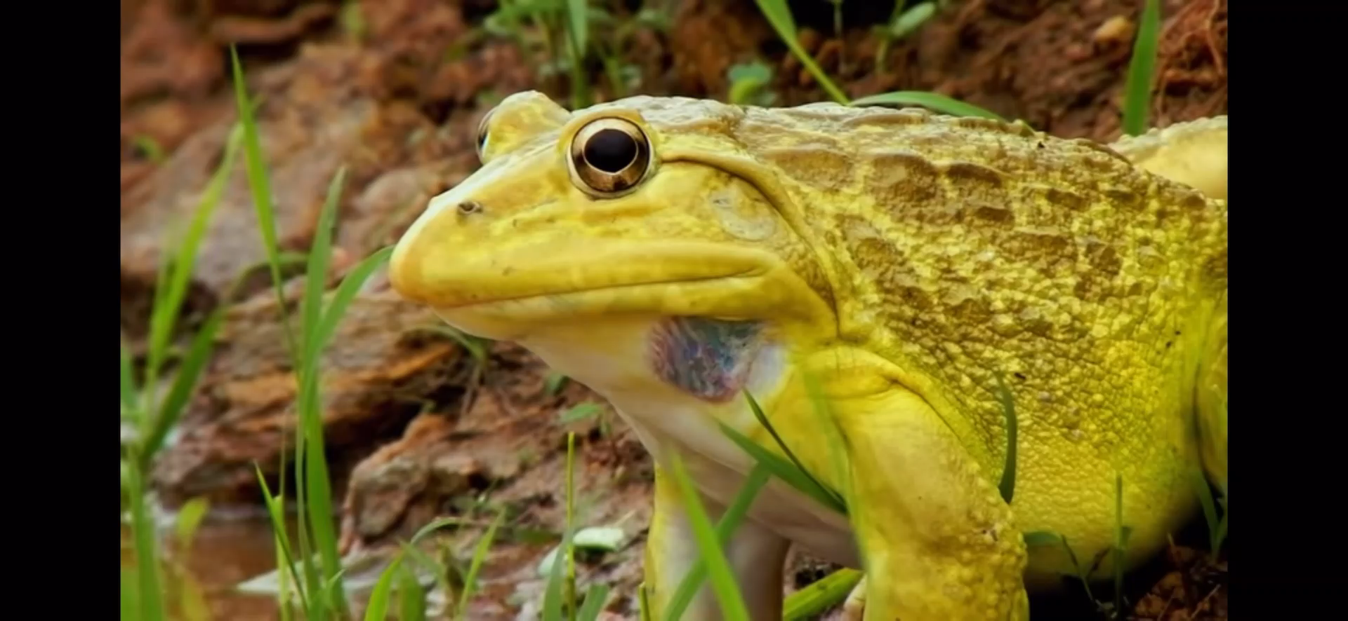

Slide 22
break

